Slide 1
Employee performance analysis using Excel
STUDENT NAME : balashanmugaraja J REGISTER NO : 312207142 NM ID :0E38062308E4B50AEAA44DA583B6329A DEPARTMENT : B.COM(MM) COLLEGE : A.M.JAIN COLLEGE

Slide 2


Slide 3


Slide 4


Slide 5


Slide 6


Slide 7
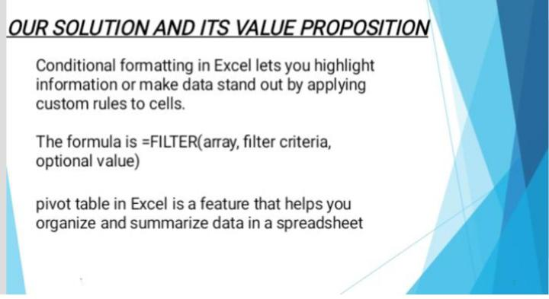

Slide 8
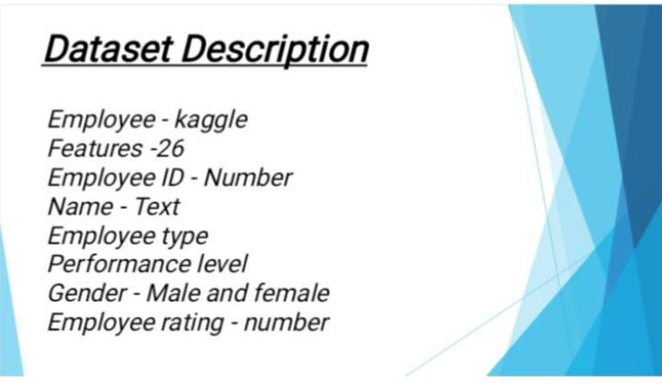

Slide 9


Slide 10
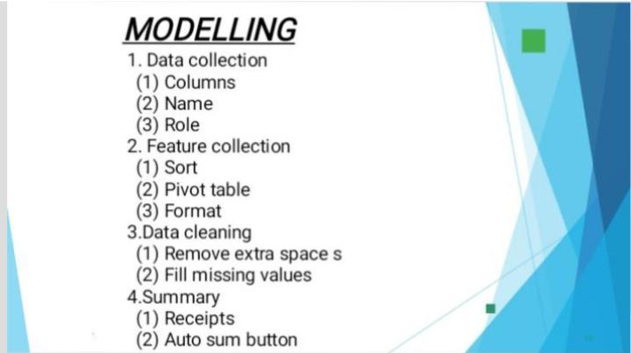

Slide 11
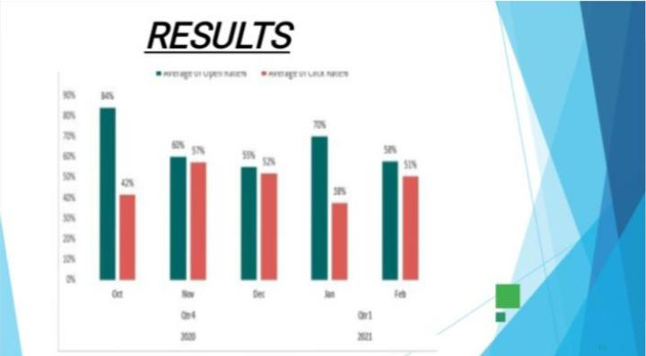

Slide 12


